Slide 1
Space Complexity

Slide 2

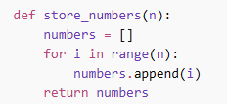
What is Space Complexity? How much extra memory an algorithm uses.
Example 1: O(1) Space
Uses fixed memory.
Example 2: O(n) Space
Memory increases with input size.

Slide 3
Compare Time vs Space
Sometimes:
Faster code → more memory
Less memory → slower code
Focus | Meaning
Time | How fast
Space | How much memory

